Slide 1
Indian Economy
A study of Indian Economy from 1960 to 2020

Slide 2
Contents
Questions & Hypothesis
Approach
Q1. Population Growth Rate (%) and GDP per capita
Q2. GDP per capita and Life expectancy
Q3. Relation between GDP and Inflation rate (%)
Deeper Analysis
Results

Slide 3
Questions and Hypothesis
Q1. Does Population growth rate (%) and GDP per capita have any relation and if it does than define how strong or weak the relationship is?
Hypothesis: Yes, the Population growth rate (%) and GDP per capita does have a relation.
Q2. Is there any influence of GDP per capita on the Life expectancy?
Hypothesis: Yes, GDP per capita has an influence on the Life expectancy.
Q3. What kind of relationship has been there between GDP and Inflation rate (%) in India in these 60 years?
Hypothesis: No, there was no such kind of relation between Inflation rate and GDP.

Slide 4
Approach
Data tables downloaded from The World Bank and Index Mundi.
Formatted, compiled, and cleaned in one single dataset using Ms-Excel.
For statistical inference and other analysis of the data, Python and Ms-Excel was used.
Graphical Visualizations were created using Power Bi.

Slide 5
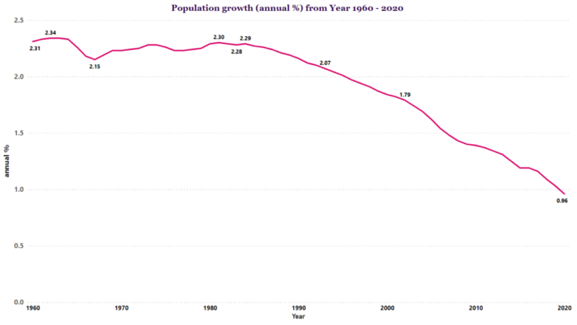
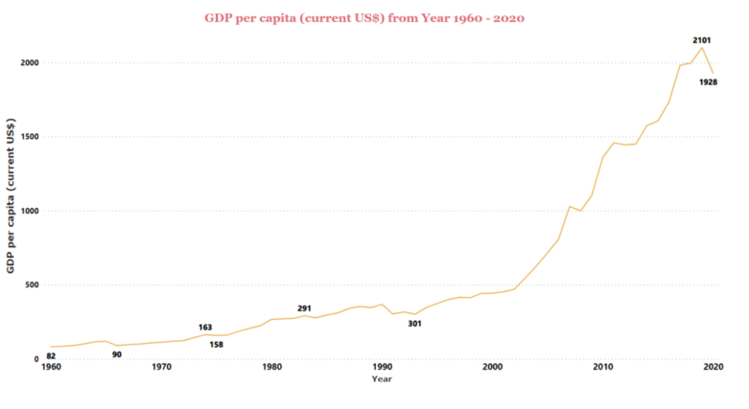
Q1 Population Growth Rate (%) and GDP per capita
Population growth rate (%) and GDP per capita does have a relation that can be defined by using covariance, which shows that both of them are negatively related, and they tend to move in opposite direction. And the correlation between Population growth rate (%) and GDP per capita is a strong negative relation with a value of -0.96.

Slide 6
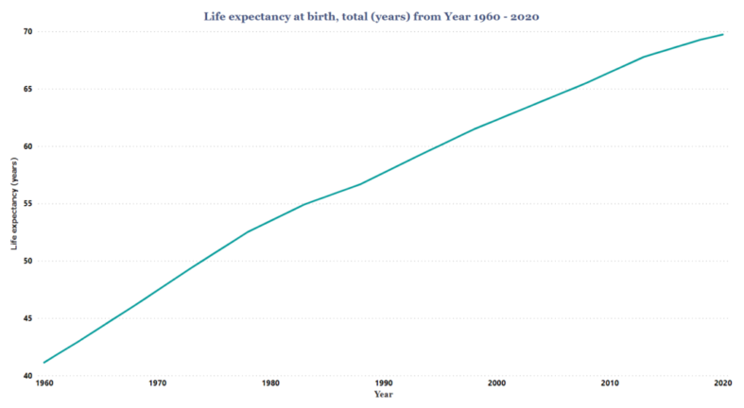
Q2. GDP per capita and Life expectancy
GDP per capita has a direct influence on the Life expectancy at birth. The relation between GDP per capita and Life expectancy is positively related which means they tend to go in the same direction. Also, correlation defines the relation to be a strong positive relation between both the parameters with a value of 0.83.

Slide 7
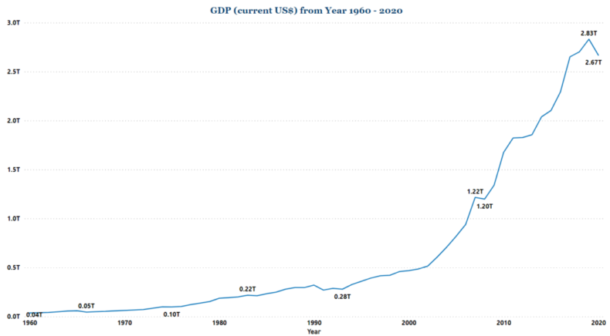
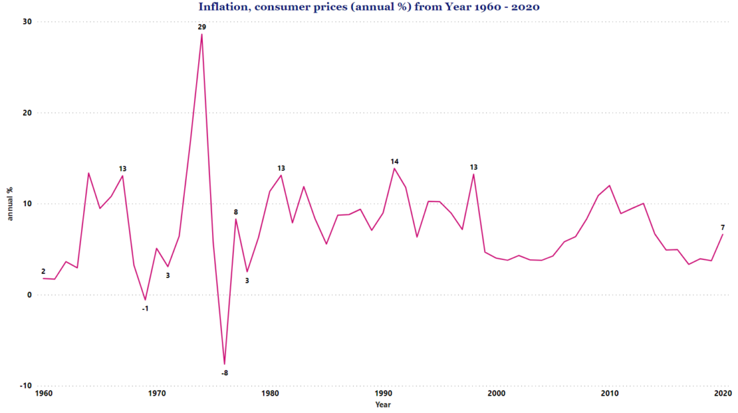
Q3. Relationship between GDP and Inflation rate (%)
In the context of Indian economy in a span of these 60 years, GDP and Inflation rate (%) do have a relation, but the correlation defines the relation to be very weak with just a value of -0.1.

Slide 8
DEEPER ANALYSIS
The Highest GDP growth (annual %) within these 60 years was of 9.63% in year 1988, with 2nd highest being 9.15% in 1975.
Indian economy had only 4 such years where the growth rate was in negative, with the lowest growth rate of -7.25% in year 2020, -5.24% in year 1979, -2.6% in 1965 and -0.55% in 1972.
-7.63% inflation rate in year 1976 was the lowest in these 60 years and -0.58% in 1969 was the 2nd lowest.
In year 1974, India had highest Inflation rate of 28.60% and 13.87 in year 1991, was the 2nd highest.
From 1960 to 1983, the population growth (annual %) had no such trend but from year 1984 we can clearly see a downfall in annual %, every year.

Slide 9
DEEPER ANALYSIS
1. The Average GDP growth (%) within the span of these 60 years was of 4.94%.
2. The Average Life expectancy within the span of these 60 years was of 57 years.
3. The Average Exports of goods and services (in % of GDP) within the span of these 60 years was 10.89%.
4. The Average Imports of goods and services (in % of GDP) within the span of these 60 years was 12.75%.
5. The Average GDP per capita within the span of these 60 years was $576.56.
6. The Average Population growth (%) within the span of these 60 years was 1.93%.
7. The Average Inflation rate (%) within the span of these 60 years was 7.41%.

Slide 10
Final Results
1. Does Population growth rate (%) and GDP per capita have any relation and if it does than define how strong or weak the relationship is?
Yes, they are negatively related and, they tend to move in opposite direction.
2. Is there any influence of GDP per capita on the Life expectancy?
Yes, there is a direct influence, and the relation is positive which means they tend to go in the same direction.
3. What kind of relationship has been there between GDP and Inflation rate (%) in India in these 60 years?
They do have a relation, but the correlation defines the relation to be very weak with just a value of -0.1.

